Slide 1
Sanitation Assainissement Eau Potable (SAEP)

Slide 2
S.A.E.P
Accessibility of the platform

Slide 3
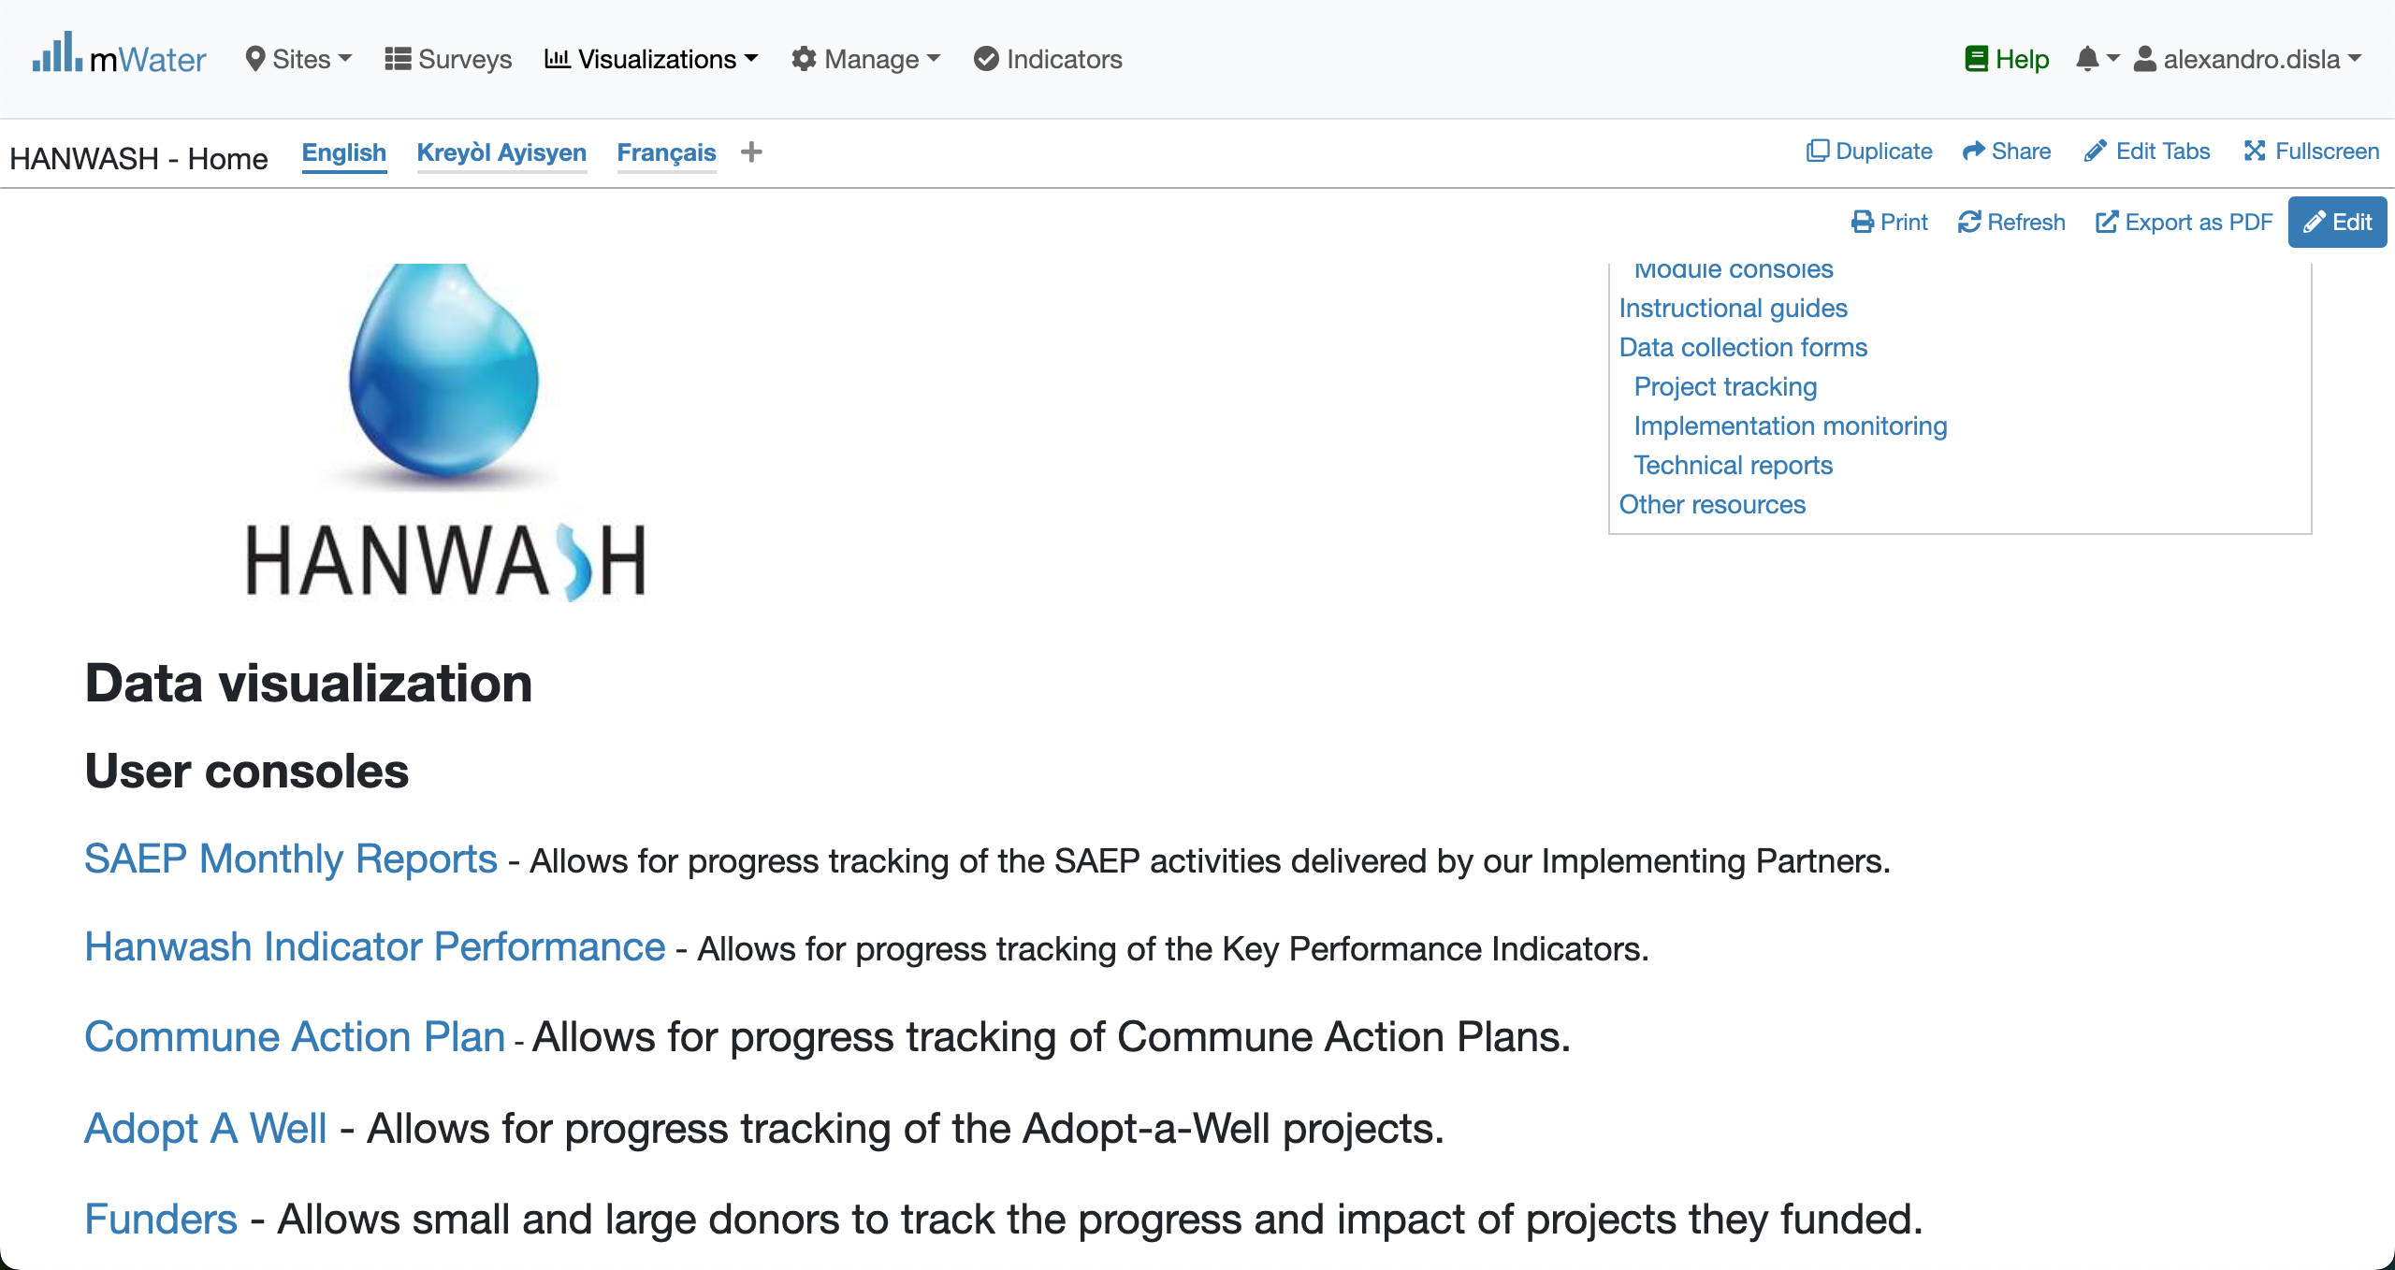
Hanwash HOME
URL LINK : http://go.mwater.co/hanwash

Slide 4
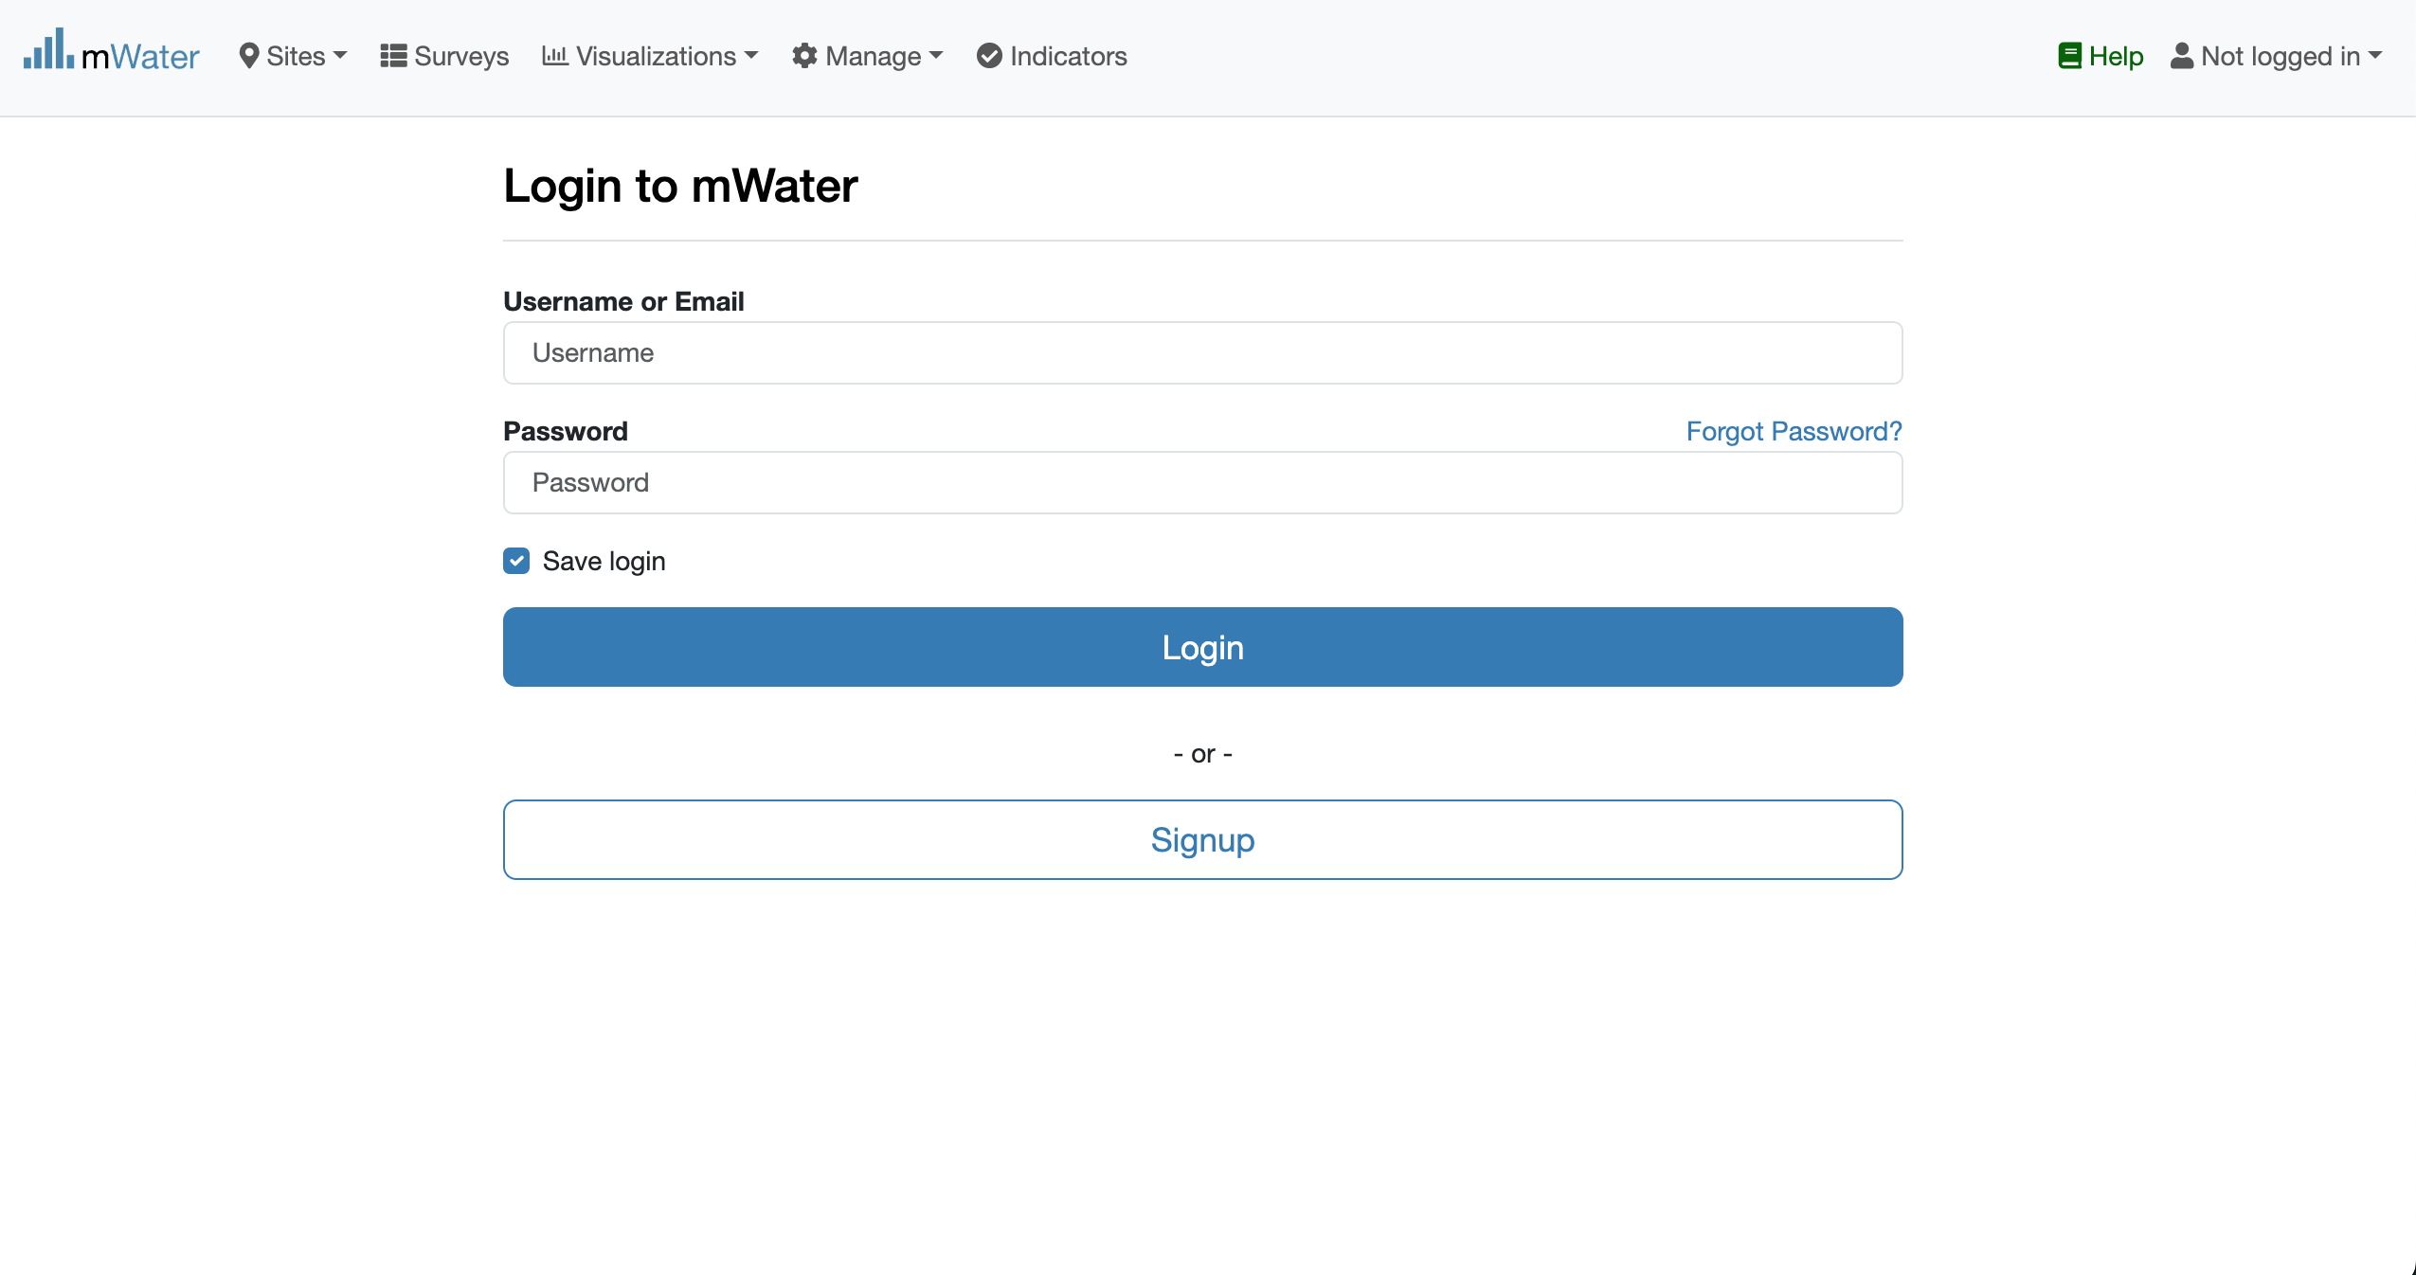
Access The SAEP & Login process
Click on the HIP url link
Log status indicator
Please enter your Credentials

Slide 5

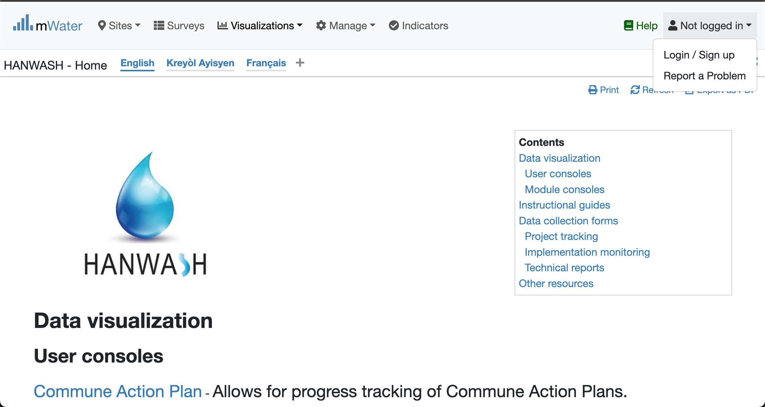


Login Process (2nd scenario)
Click to Login or Signup
Please Click on this selection box
Please enter your Credentials

Slide 6
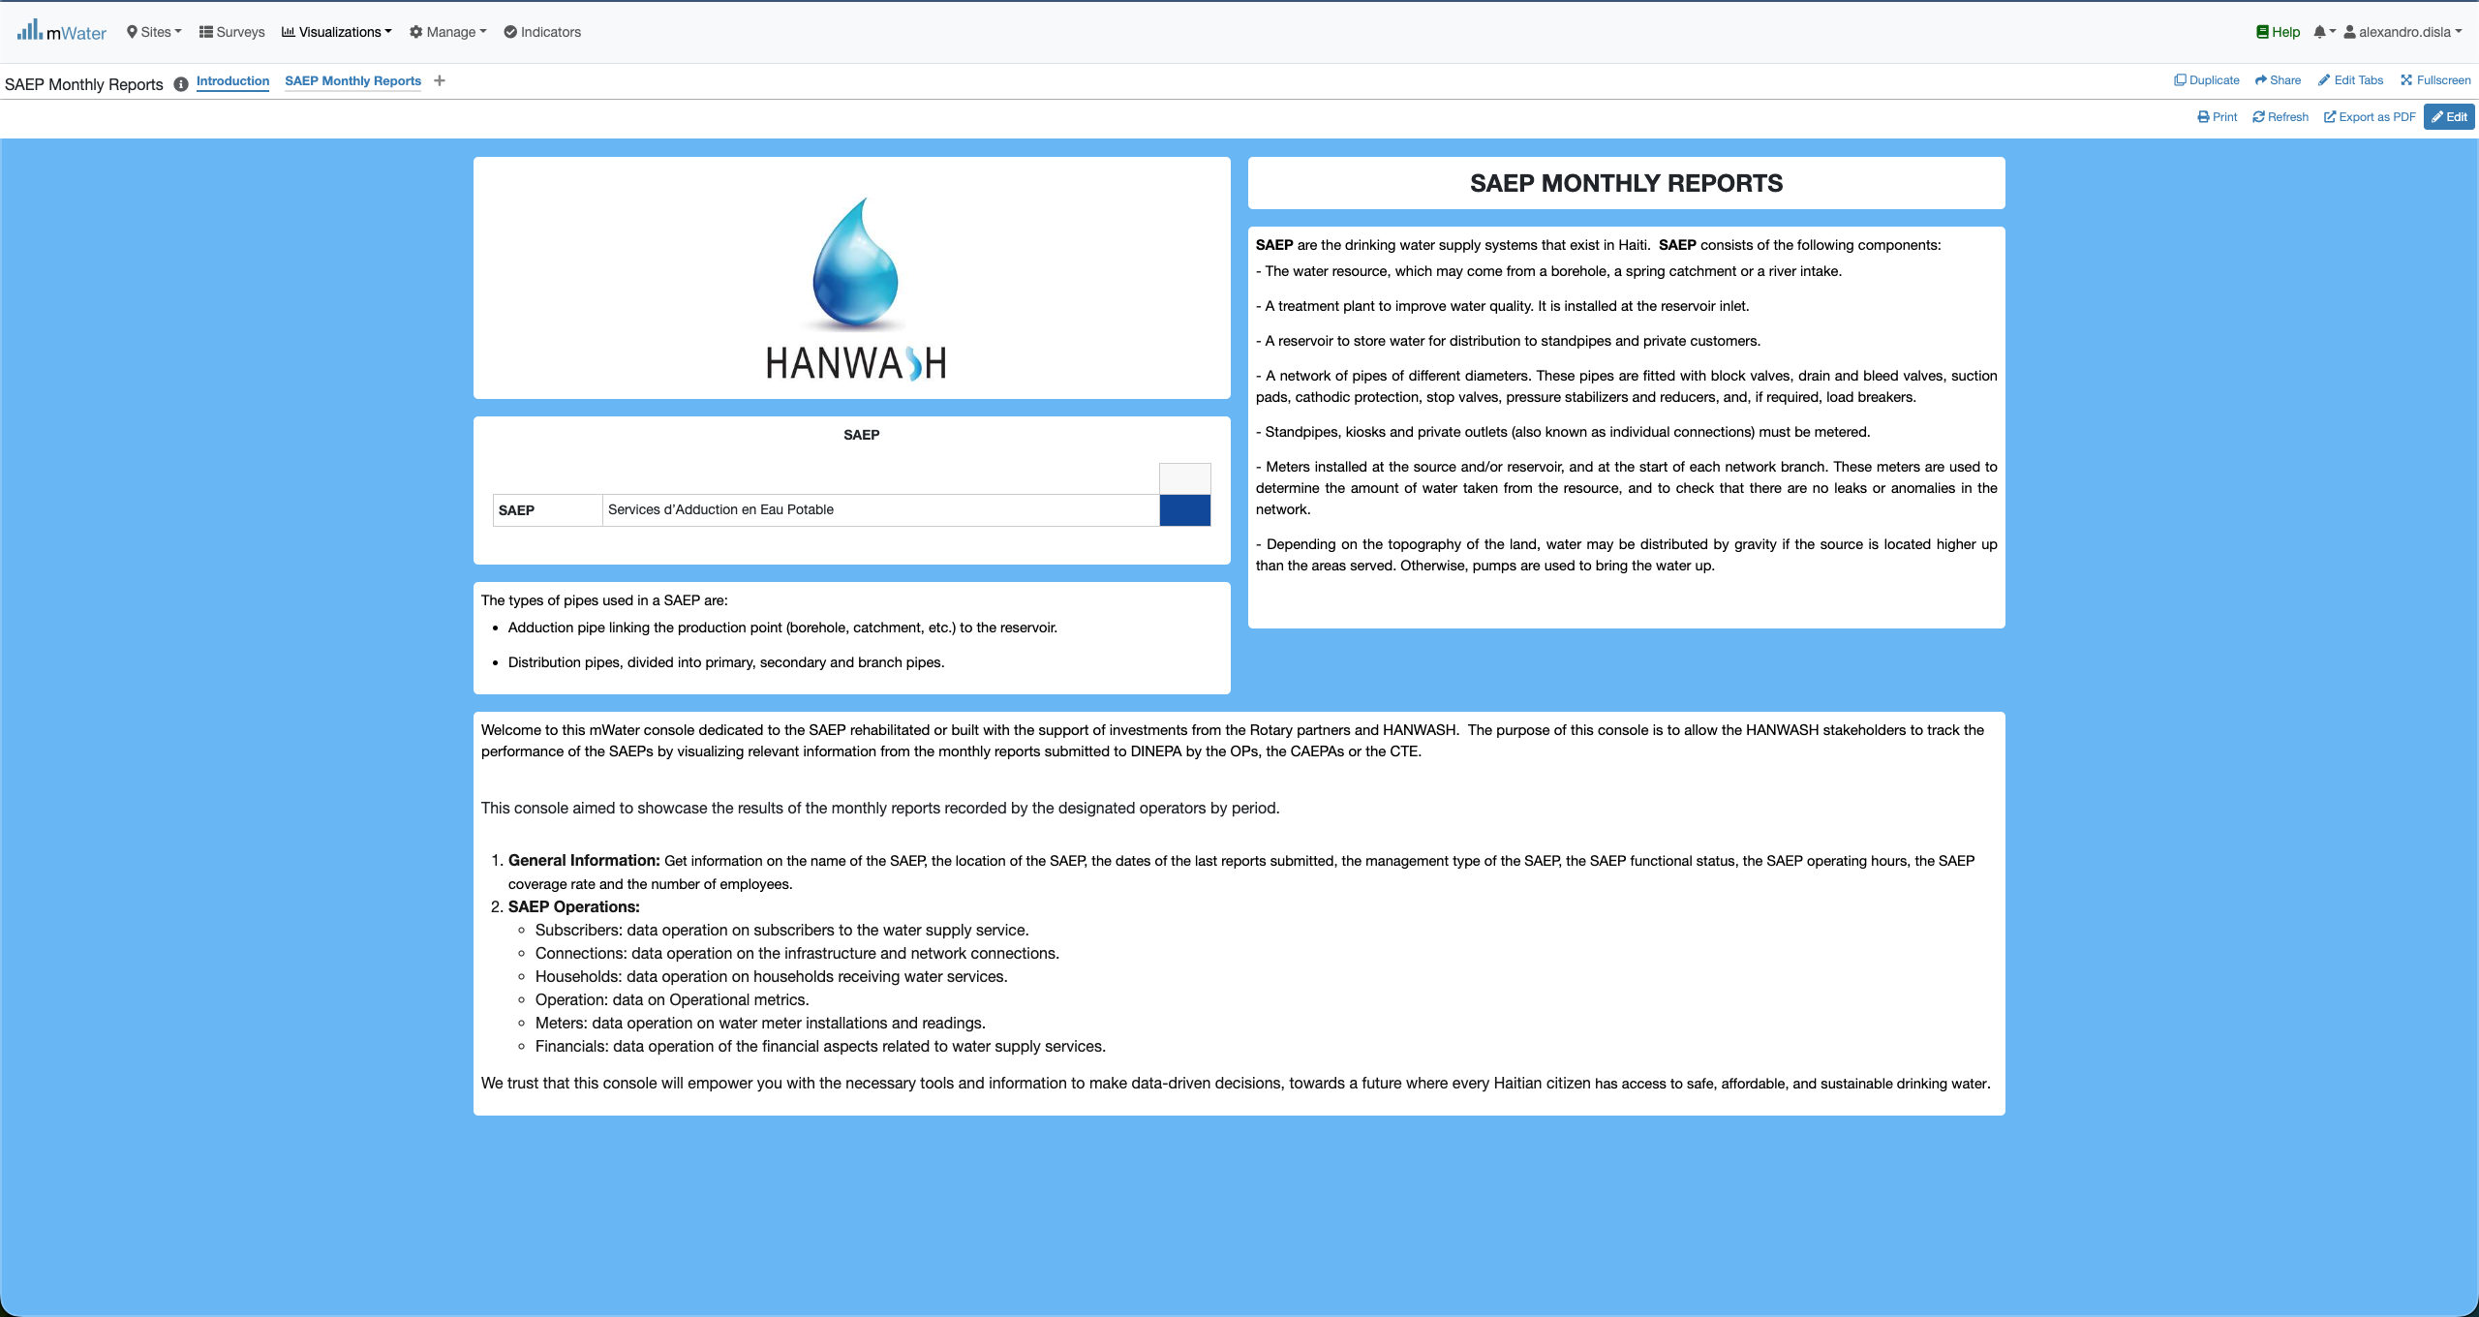
HIP Console overview

Slide 7
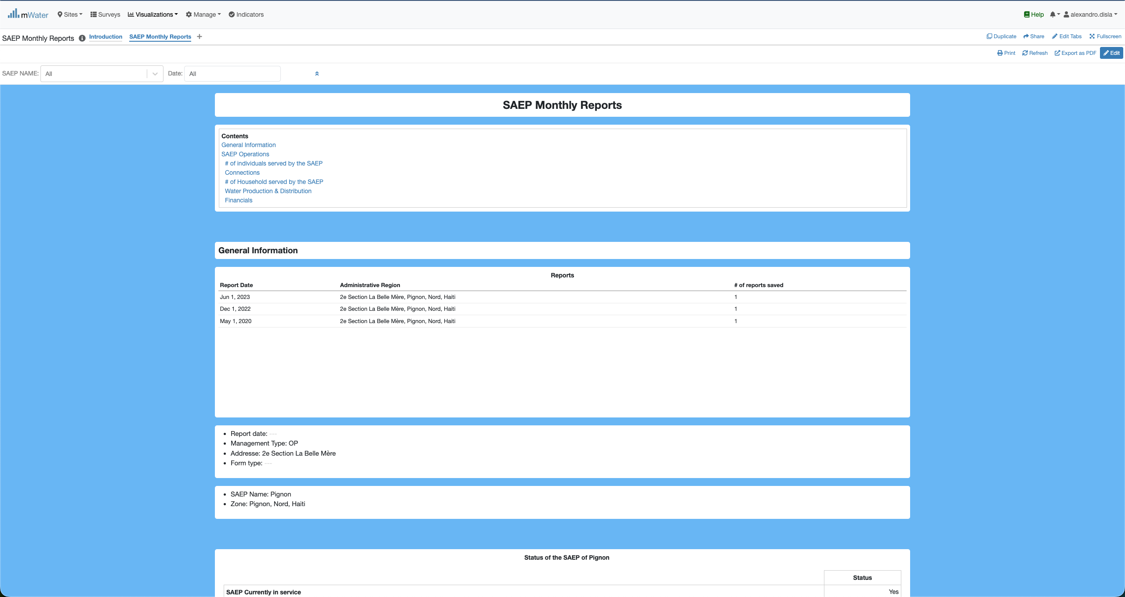
HIP Console overview

Slide 8
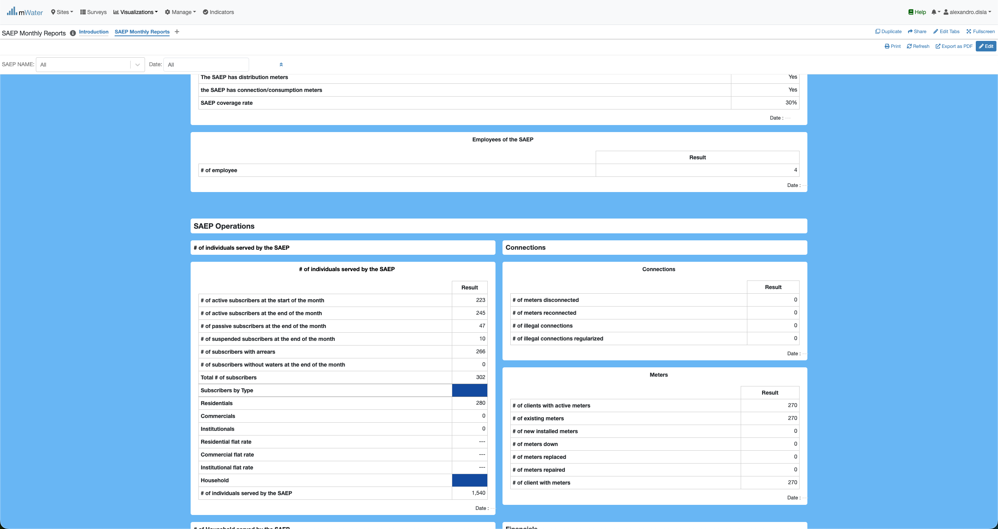
HIP Console overview

Slide 9
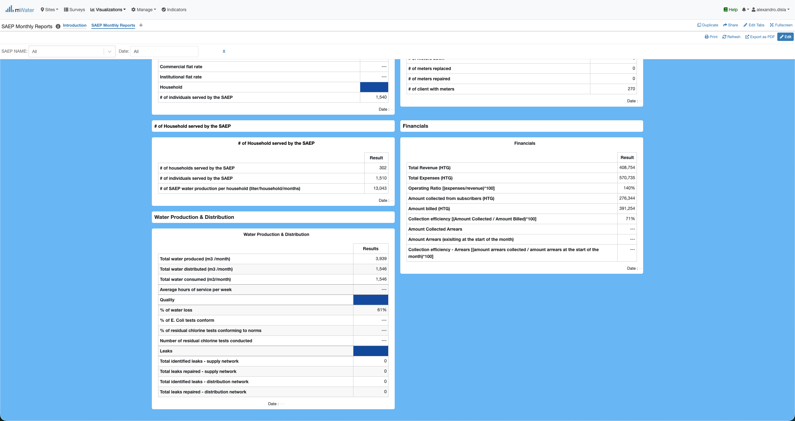
HIP Console overview

Slide 10
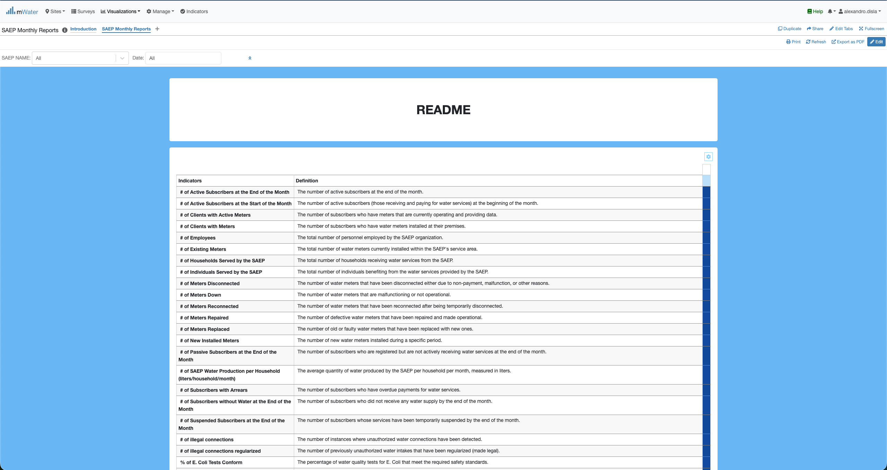
HIP Console overview

Slide 11
Functionalities
Functionalities available in the console

Slide 12
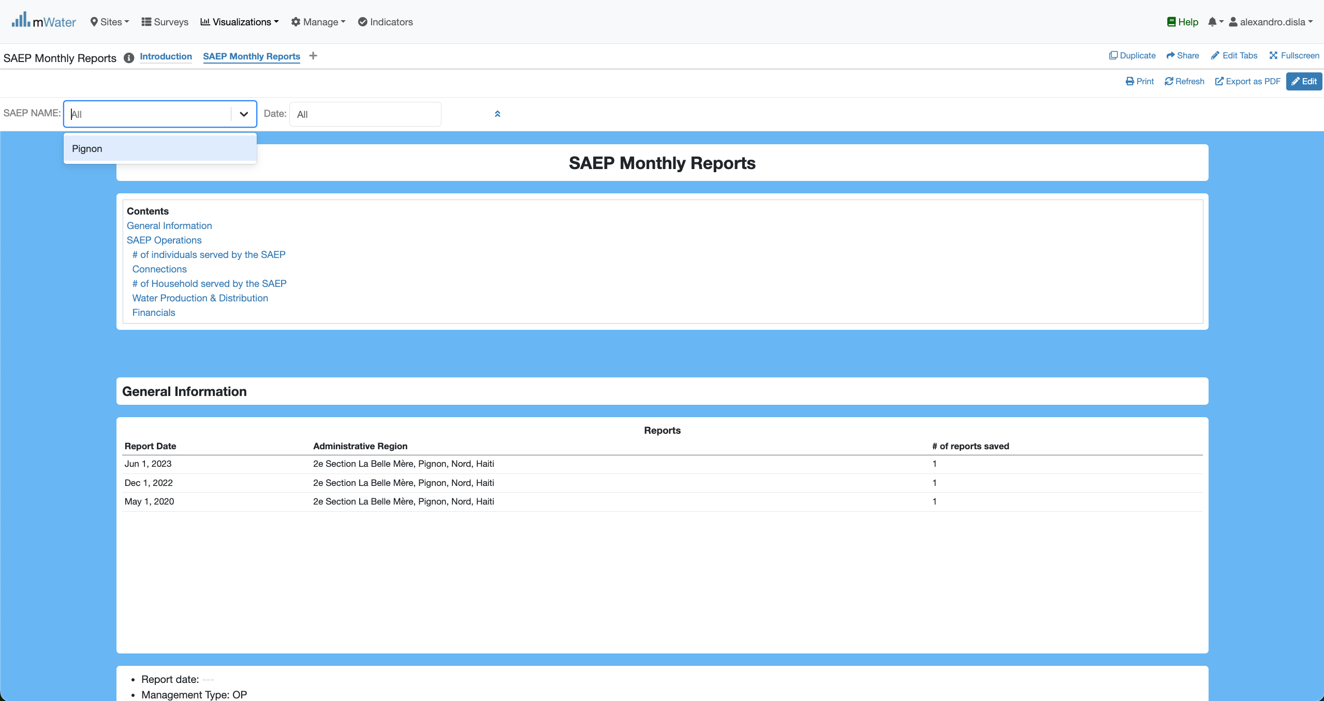
Quick filters
The SAEP Name and any future saep will be display in this dropdown list.

Slide 13
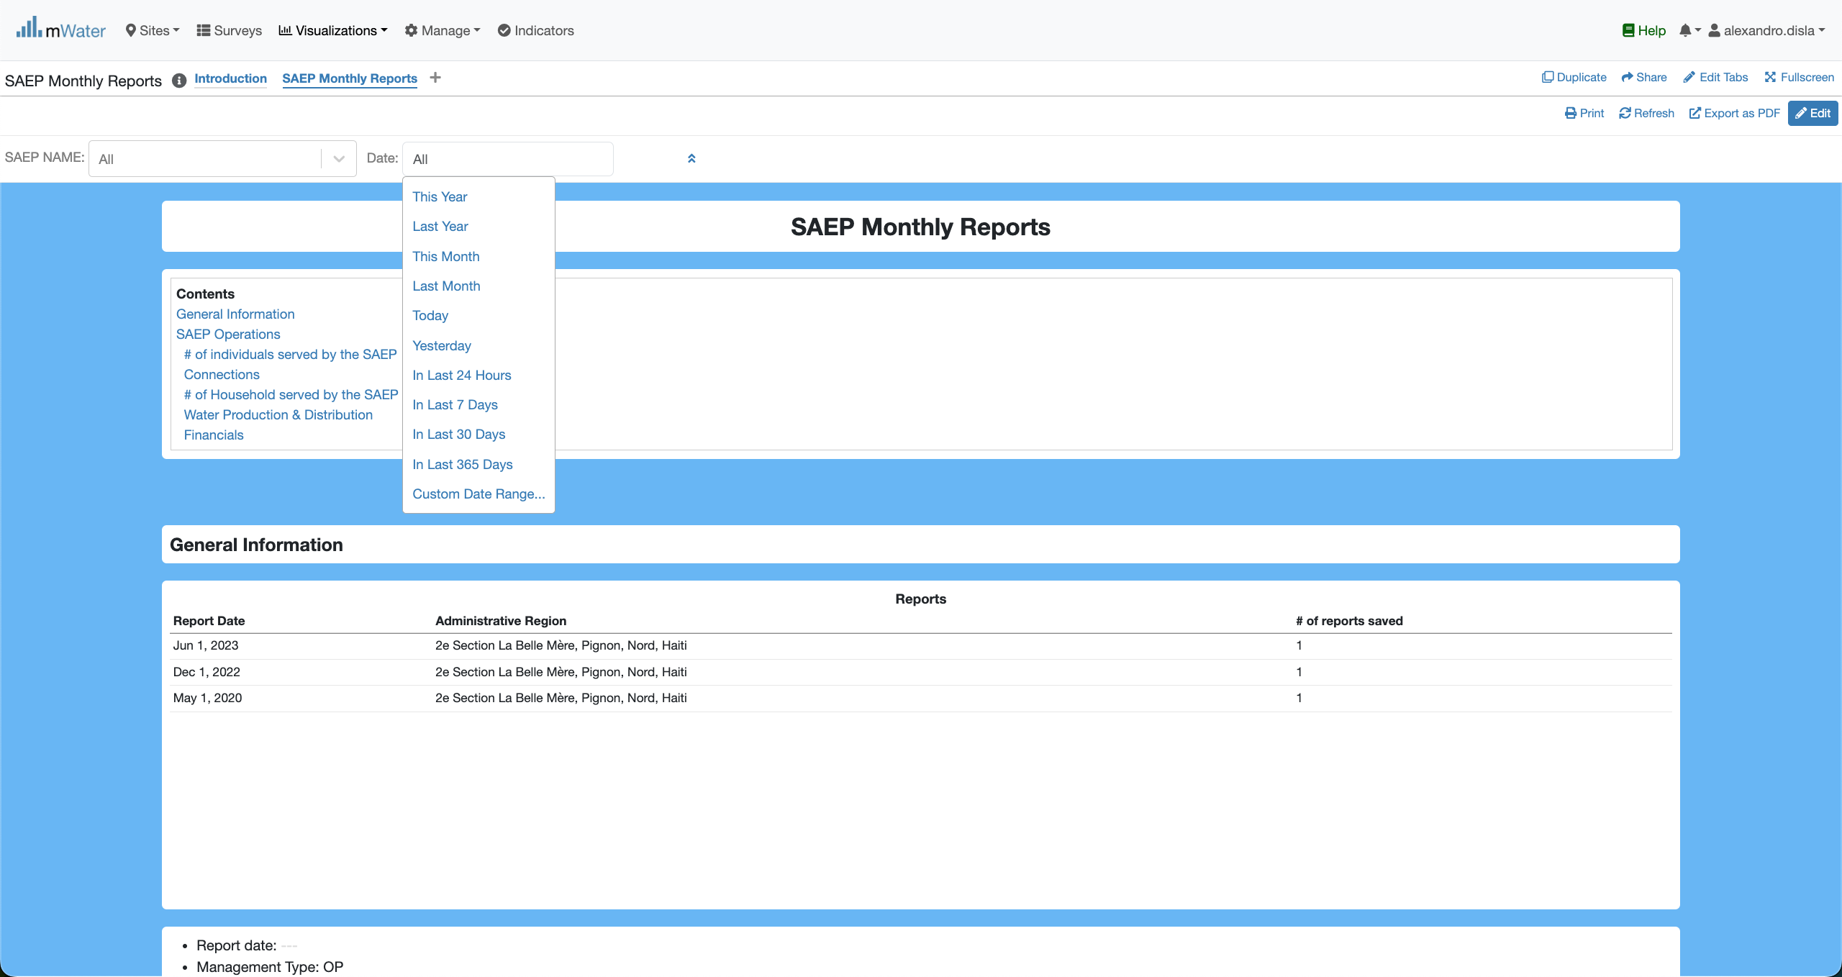
Quick filters
The Date offers us the full flexibility to work filter for a specific day or period.
This section will display all the available report for all the saep. Right now, it displays the reports for Pignon. It will help for the selection of the period.

Slide 14
Quick filters
The Date offers us the full flexibility to work filter for a specific day or period.
This section will display all the available report for all the saep. Right now, it displays the reports for Pignon. It will help for the selection of the period.

Slide 15
Main
Effect of The Quick Filters

Slide 16
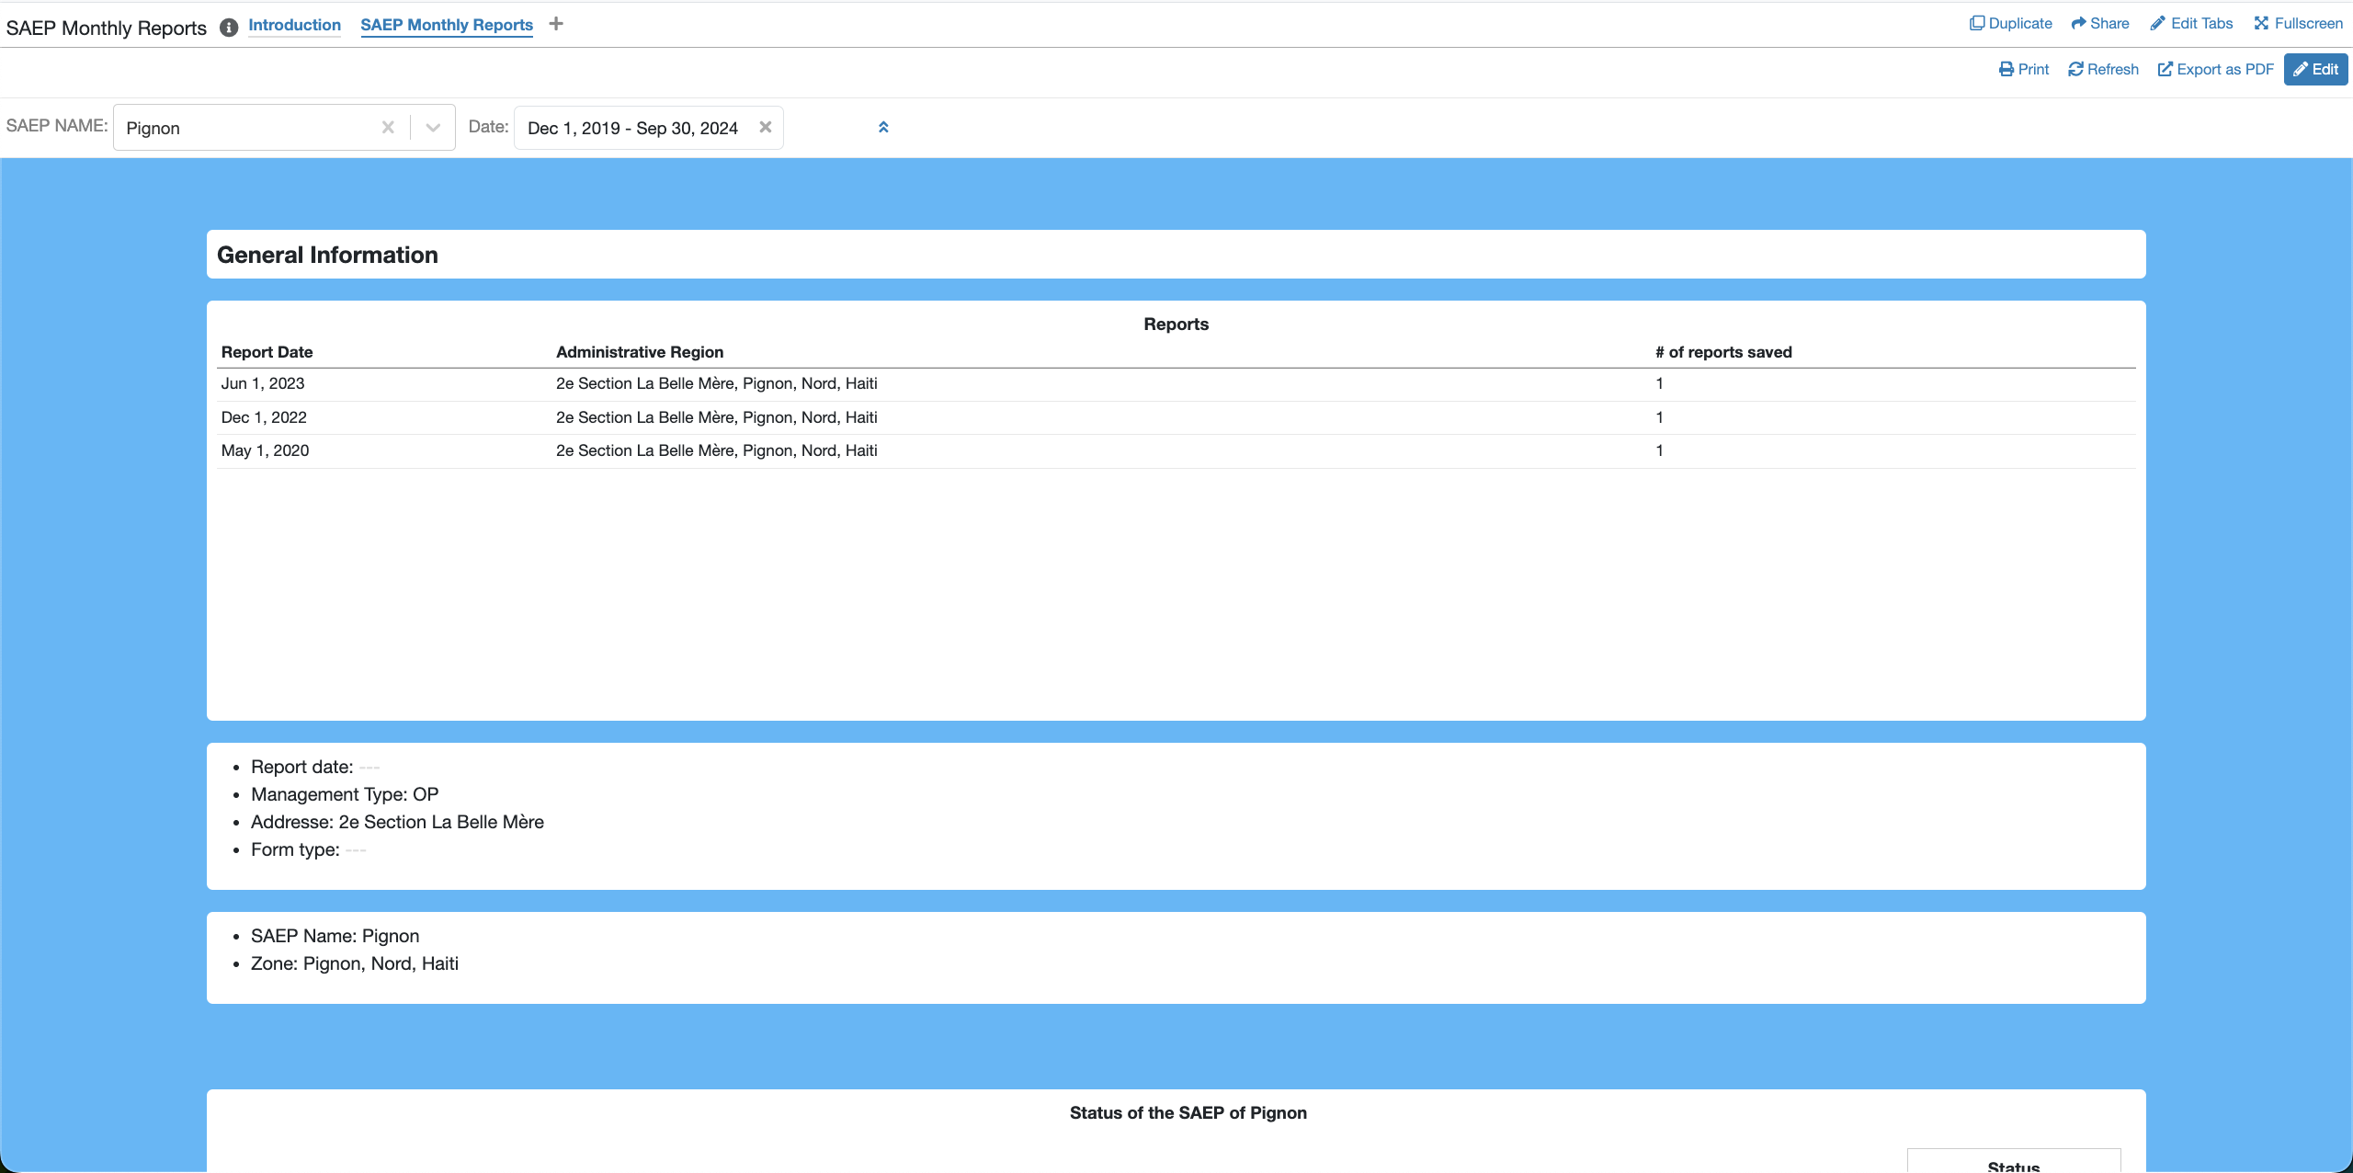
Quick Filters Selection
As highlighted, the date period covers all the available reports.

Slide 17
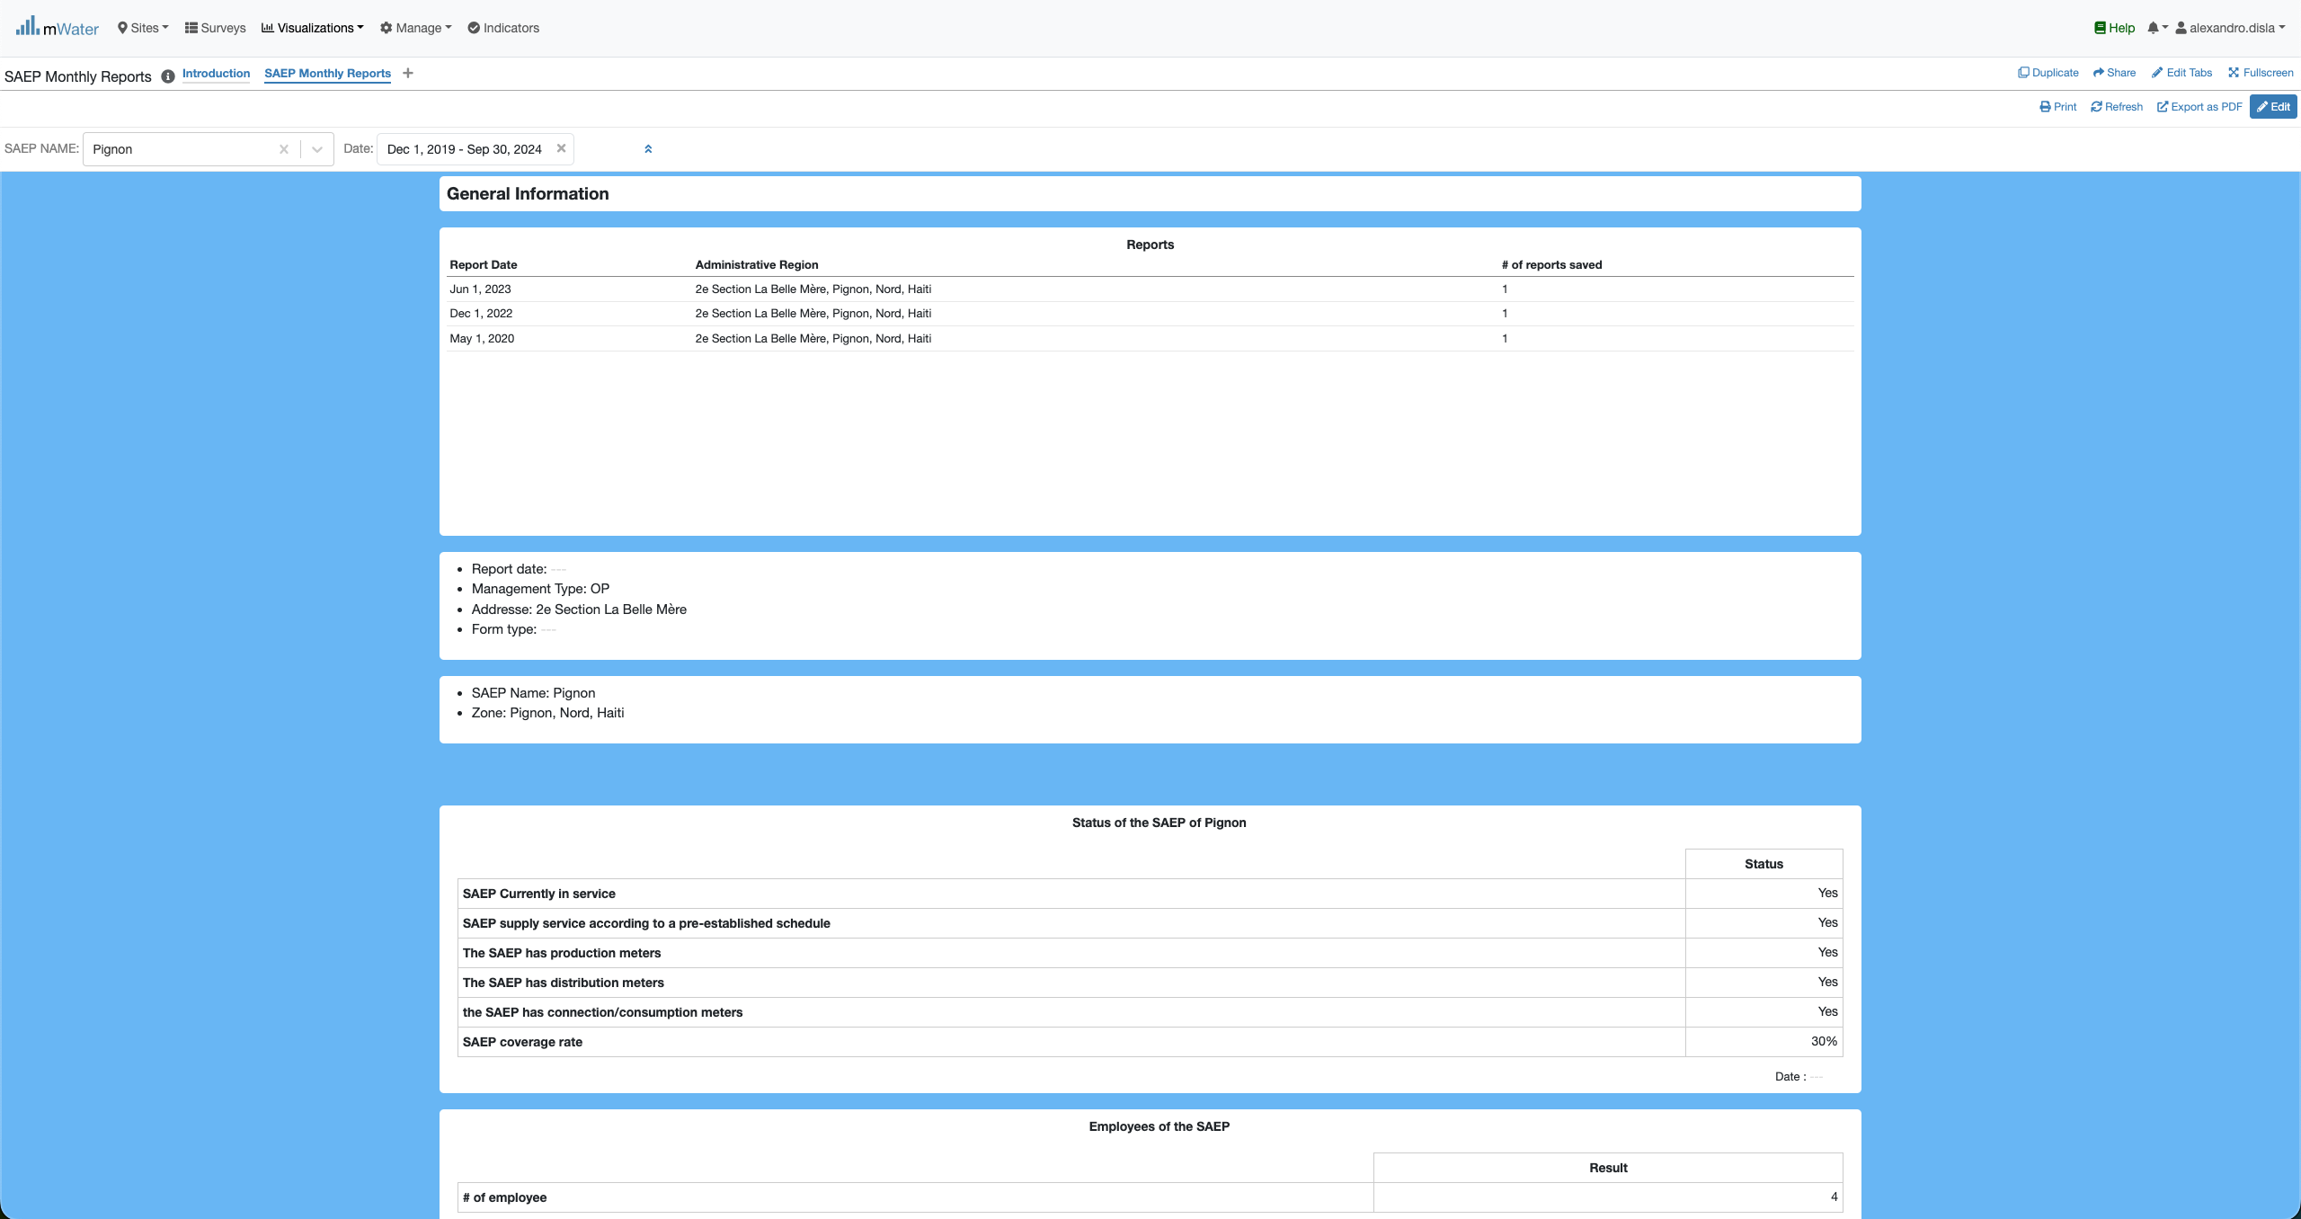
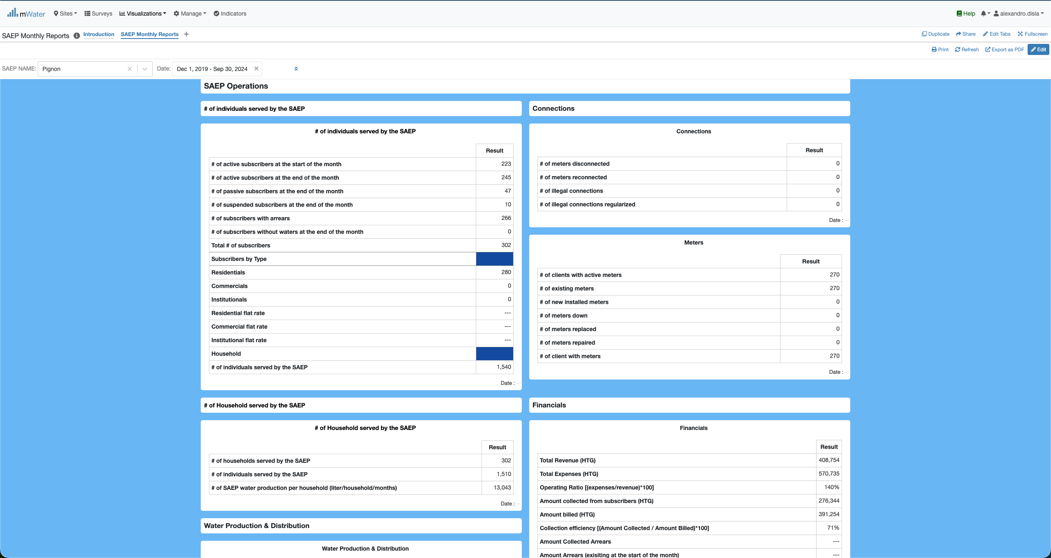
Quick Filters Selection
The General information section
The saep operation section

Slide 18
Readme section
This readme is in place to help better understand the key information displayed in the general information and operation sections.

